Slide 1
Water Quality Monitoring System
Presented by
S.Shiny Gladis

Slide 2
BLOCK DIAGRAM
Input Module
OUTPUT MODULE
POWER SUPPLY
BREAD BOARD
ARDUINO UNO
NODE MCU
JUMPERS
GRAVITY ANALOG pH SENSOR
DS18B20 TEMPERATURE SENSOR
SOIL MOISTURE SENSOR
DISPLAY DEVICE(MOBILE)

Slide 3
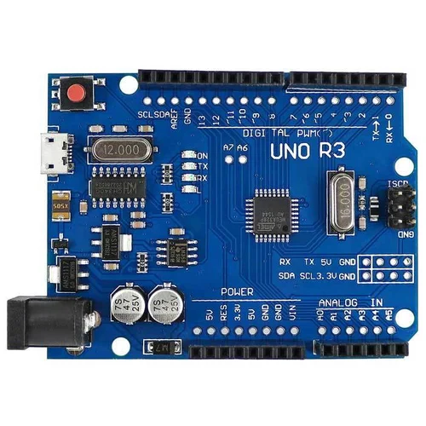
Arduino UNO
Data Collection
Data Processing
Data Logging
Wireless Communication
Automation
User Interface:
Low-Power Mode

Slide 4
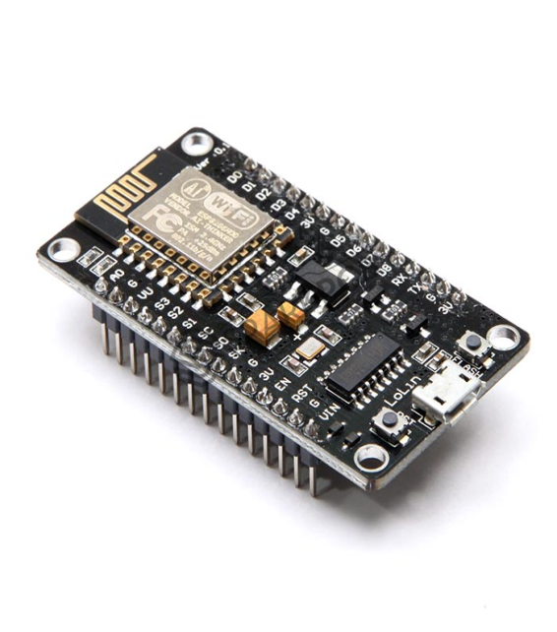
Node MCU
Sensor Interface
Data Collection
WirelessCommunication
Data Logging
Remote Monitoring
Real-time Alerts

Slide 5
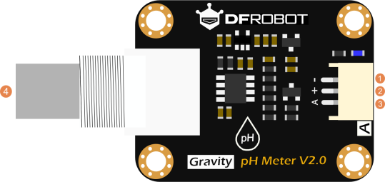
Gravity Analog pH sensor
Analog Output
High Accuracy
Easy to Use
Calibration
Wide Applications

Slide 6
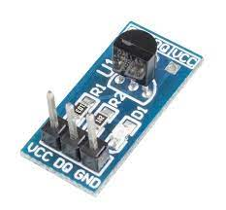
DS18B20 temperature sensor
Calibration
Temperature Measurement
Data Logging and Analysis
Environmental Monitoring
Energy Efficiency
Early Warning System

Slide 7
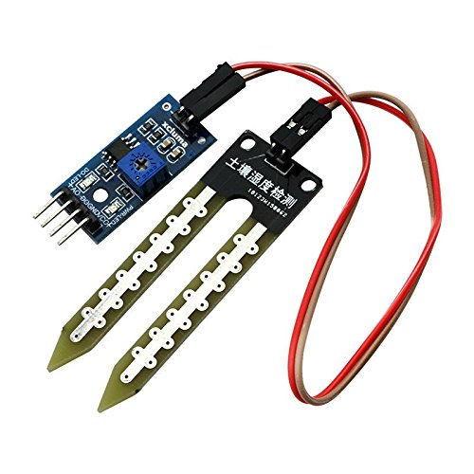
Soil Moisture Sensor
Groundwater Monitoring
Flood Monitoring
Irrigation Management
Watershed Monitoring
Wetland
Aquatic Ecosystem Monitoring
Erosion Control
Water Conservation in Landscaping
Remote Sensing

Slide 8
Power supply
Low-Power Components:
Choose sensors, microcontrollers, and communication modules that are energy-efficient. Low-power components extend the system's battery life significantly, reducing the frequency of battery replacements or recharging.

Slide 9
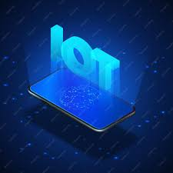
DISPLAY DEVICE
An android app is developed using the MIT app inverter tool.
This app provides a feature to visualize,monitor and analyze via mobile.

Slide 10
Python code
import random
import time
import matplotlib.pyplot as plt
class WaterQualityMonitor:
def __init__(self):
self.timestamps = []
self.ph_values = []
self.turbidity_values = []
def collect_data(self):
while True:
timestamp = time.strftime("%Y-%m-%d %H:%M:%S")
# Simulate sensor data (replace with actual sensor readings)
ph = round(random.uniform(6.5, 8.5), 2)
turbidity = round(random.uniform(0.1, 50.0), 2)
self.timestamps.append(timestamp)
self.ph_values.append(ph)
self.turbidity_values.append(turbidity)
time.sleep(5) # Simulate data collection every 5 seconds
def plot_data(self):
plt.figure(figsize=(12, 6))
plt.plot(self.timestamps, self.ph_values, label='pH')
plt.plot(self.timestamps, self.turbidity_values, label='Turbidity')
plt.xlabel('Timestamp')
plt.ylabel('Value')
plt.title('Water Quality Monitoring')
plt.legend()
plt.xticks(rotation=45)
plt.show()
if __name__ == "__main__":
monitor = WaterQualityMonitor()
monitor.collect_data()

